Slide 1
Azure Certification Prep Tips

Slide 2
Test Format
Time Limited
You can’t navigate between parts of the test
Survey at the end that doesn’t count against your time

Slide 3
What are the certs?
https://buildazure.com/certifications/
https://www.microsoft.com/en-us/learning/certification-overview.aspx

Slide 4
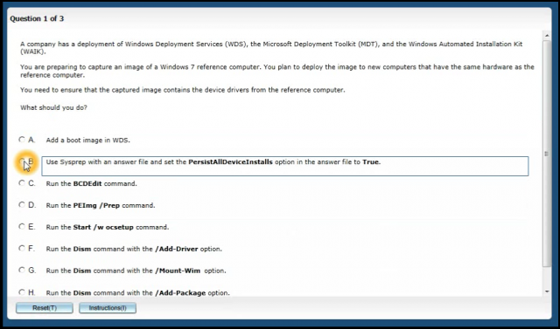
Test Format
Repeated Answers:

Slide 5
Test Format
Best Answer:

Slide 6
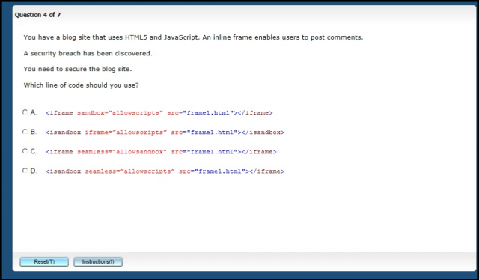
Test Format
Multiple choice:

Slide 7
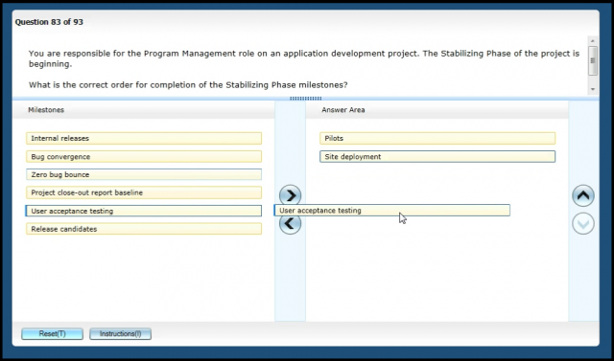
Test Format
Interactice
Questions:

Slide 8
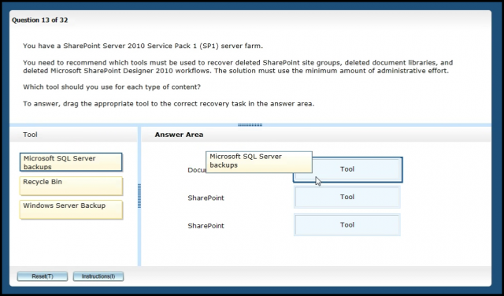
Test Format
Drag and Drop:

Slide 9
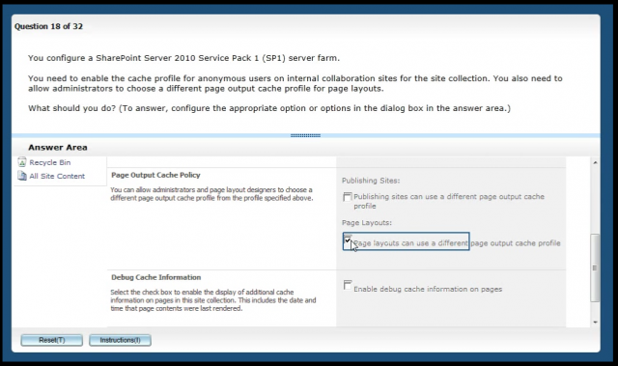
Test Format
Active Screens
Simulations

Slide 10
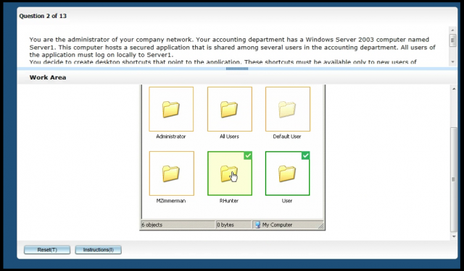
Test Format
Graphical Choices:

Slide 11
Test Format
Case Studies
Pick a certain number of answers
Pick a certain number of answers and order them

Slide 12
Test Tips
They are looking for the best answer, not the perfect answer
When in doubt, think like Microsoft Marketing/Product Team
Details. Details. Details.

Slide 13
Why?
It’s a great way to learn
Learn about things you wouldn’t bump into on your own
Fill in the gaps on what you do use
Learn Best practices and new features
Validate your knowledge
Looks good on Linkedin and a resume
Access to the MSP Store

Slide 14
How To Prepare
Know how you Learn!
Visual, Audio, Tactile, Hands On, Video
Get your fingers dirty in Azure
Set up a new account and get $200 credit for 30 days.
Do Labs: https://azure.microsoft.com/en-us/training/

Slide 15
Learning Resources
Instructor Lead Courses
Watch for deals
Azure Triple Pack or Single Pack
Exam Replay: https://www.microsoft.com/en-us/learning/offers.aspx
Microsoft Press Books: https://www.microsoftpressstore.com/
Free E-books: Many Sources
Platform Overview: https://azureplatform.azurewebsites.net/en-us/

Slide 16
Practice Exams
Measure UP
Many exam pack and Exam Replay include practice test
Many Books include Practice Exams
Caution on Practice Exams

Slide 17
Video Learning
Microsoft Learn
OpsGility
Other Video platforms:
Pluralsight
CBT Nuggets
Open EDX
Etc…

Slide 18
Azure Resources
Build Azure: https://buildazure.com
Build Azure Slack Group: https://buildazureslack.azurewebsites.net/
Azure Blog: https://azure.microsoft.com/en-us/blog/
CIA Opps: http://www.ciaops.com/

Slide 19
Azure Podcasts
Azure Podcast: http://azpodcast.azurewebsites.net/
Microsoft Cloud Show: http://www.microsoftcloudshow.com/
Microsoft Cloud IT Pro Podcast: https://www.msclouditpropodcast.com/
Run As Radio: http://runasradio.com/
.Net Rocks: https://www.dotnetrocks.com/

Slide 20
Wrap up:
Jump In
You always fail the tests you don’t take

